Slide 1
ECE/CS 552: Integer Multiplication and Division
Boone Severson
Lecture notes based in part on slides created by Joshua San Miguel, Mikko Lipasti, Mark Hill, David Wood, Guri Sohi, John Shen and Jim Smith

Slide 2
Announcements
Final exam in 2 weeks: Tue 12/17
  12:25 - 2:25 PM in Van Hise 494
  See Final Exam Info on Canvas
  Final exam review: Tue 12/10 in class
Project Phase 3 (+ extra credit) due Mon 12/16

Slide 3
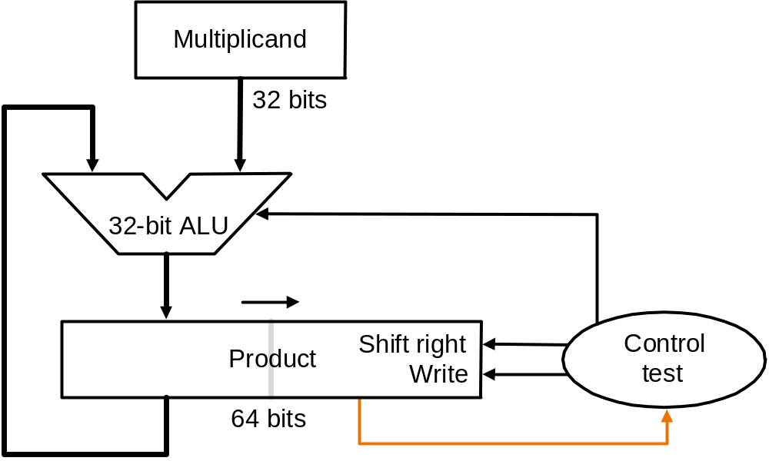
Improved Multiplier
 |  |  |  | 1 | 0 | 0 | 0
 |  |  | x | 1 | 0 | 0 | 1
 |  |  |  | 1 | 0 | 0 | 0
 |  |  | 0 | 0 | 0 | 0
 |  | 0 | 0 | 0 | 0
 | 1 | 0 | 0 | 0
0 | 1 | 0 | 0 | 1 | 0 | 0 | 0
1000
1000
1 = enable add
Multiplier
Multiplier
0000 1001
1000 1001

Slide 4
Improved Multiplier
 |  |  |  | 1 | 0 | 0 | 0
 |  |  | x | 1 | 0 | 0 | 1
 |  |  |  | 1 | 0 | 0 | 0
 |  |  | 0 | 0 | 0 | 0
 |  | 0 | 0 | 0 | 0
 | 1 | 0 | 0 | 0
0 | 1 | 0 | 0 | 1 | 0 | 0 | 0
1000
1000
1000
1000
number of adds = number of 1s in multiplier
0 = disable add
1 = enable add
0 = disable add
Multiplier
Multiplier
Multiplier
Multiplier
1001 0001
0100 1000
0100 0100
0010 0010
done

Slide 5
Booth’s Multiplier
Recall grade school trick
  When multiplying by 9:
    Multiply by 10 (easy, just shift digits left), then subtract once
    e.g., 123456 x 9 = 123456 x (10 – 1) = 1234560 – 123456
    Converts addition of six partial products to one shift and one subtraction
Booth’s multiplier applies the same principle
  e.g., Multiplying by 00001111000 (120 in decimal) is equivalent to multiplying by 00010000000 – 00000001000 (128 – 8 in decimal)
  Booth’s Encoding: Convert each run of 1s in the multiplier to a difference of powers of 2

Slide 6
Booth’s Multiplier
From right (least significant) to left (most significant) bit:
Multiplier bits | Current bit | Previous bit | Description | Operation
00001111000 | 1 | 0 | Begins run of 1s (rising edge) | Subtract (-)
00001111000 | 1 | 1 | Middle of run of 1s | Nothing (0)
00001111000 | 0 | 1 | End of run of 1s (falling edge) | Add (+)
00001111000 | 0 | 0 | Middle of run of 0s | Nothing (0)
Booth’s encoding: 000+000-000
e.g., Multiplying by 00001111000 (= 00010000000 – 00000001000)

Slide 7
Booth’s Multiplier
Multiplicand x multiplier:
  6 x 7 = 42
  0110 x 0111
  Multiplier 0111 in Booth’s encoding is +00-
0000 0110 | x –1 | 1111 1010
0000 1100 | x 0 | 1111 1010
0001 1000 | x 0 | 1111 1010
0011 0000 | x +1 | + 0010 1010
 | Final Sum: | 0010 1010 (42)
number of adds/subs = number of falling/rising edges

